Slide 1
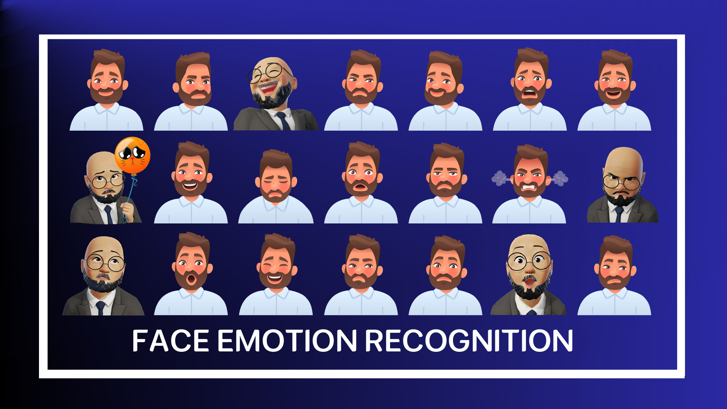

Slide 2










Our Team
Abdelrahman
Mostafa
Kamal
Ahmed Mohamed
SalahEldin
Mohamed Khaled
Hosny
Khaled Mahmoud Khaled
Mohamed Moawad
Ahmed
Ziad Mohamed
Abdelrahim
Sara Mohamed
Yousef
(2000117)
(1901084)
(2000630)
(2000676)
(2000186)
(2000758)
(2000395)
Supervised By:
DR.Hanna Bayomi
TA.Engy Emad

Slide 3




Agenda
01
Introduction
02
Motivation
03
Problem Definition
04
Related Work
05
Background
06
Methodology
07
Conclusion
08
Future Work

Slide 4

Introduction
Face emotion recognition is a pioneering technology that uses artificial intelligence and machine learning to analyze facial expressions and understand human emotional states. Relying on deep learning algorithms and neural networks, it can identify emotions like happiness, sadness, anger, surprise, fear, and disgust. This technology has wide-ranging applications in fields such as healthcare, marketing, education, and security, enhancing human-machine interaction and offering deeper insights into human emotions.

Slide 5
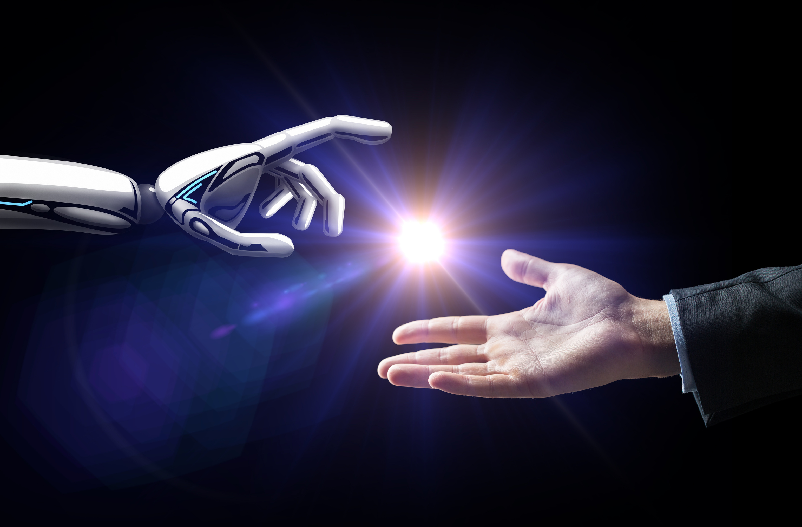
Motivation
Facial Emotion Recognition (FER) is useful for many domains. It makes computers and devices more friendly by sensing and reacting to human emotions. It helps psychologists and neuroscientists study and measure emotions and expressions. It also improves security systems by identifying people’s emotional states and detecting suspicious faces.
The motivation for applying Facial Expression Recognition (FER) technology spans various domains and purposes. Here are some key motivations

Slide 6
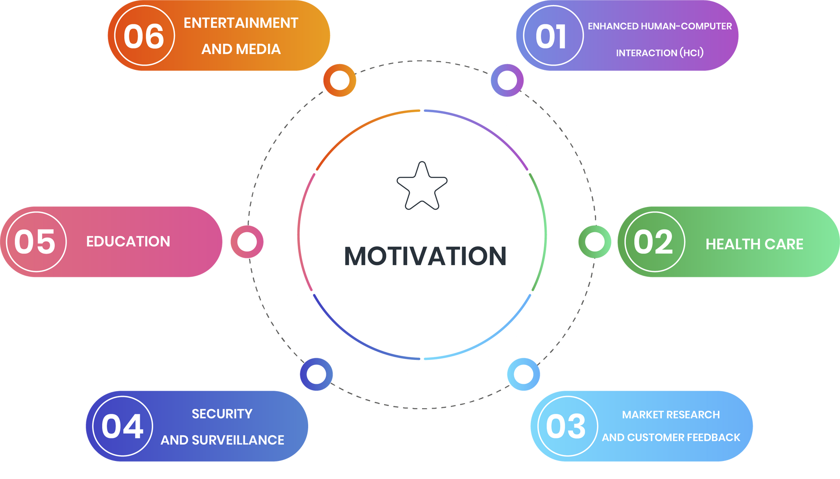
Cont`d

Slide 7
Problem Definishion
Face emotion recognition is a crucial component in human-computer interaction, artificial intelligence, and various applications such as human-computer interfaces, virtual reality, and customer sentiment analysis. The ability to accurately detect and interpret facial expressions can enhance user experiences and enable more natural interactions between humans and machines.

Slide 8

Related Work
PAPER NAME | NAME | YEAR | ALGORITHM | ACCURECY
DeXpression: Deep Convolutional Neural Network for Expression Recognition
DeXpression: Deep Convolutional Neural Network for Expression Recognition
Static Facial Expression Analysis in Tough Conditions: Data, Evaluation Protocol and Benchmark
Improving Facial Emotion Recognition Systems Using Gradient and Laplacian Images
Real-time Convolutional Neural Networks for Emotion and Gender Classification
NUMBER OF CLASS
NUMBER Of Picture
SIZE
CKP
2016
CNN
99.6%
7
999
5.44MB
MMI
2016
CNN
98.63%
6
494
93.2MB
SFEW2.0
2015
SVM
43.71%
7
1760
48.9MB
KDEF
2017
KNN
85.51%
7
4900
486MB
FER-2013
2017
CNN
66%
7
7178
53.8MB

Slide 9

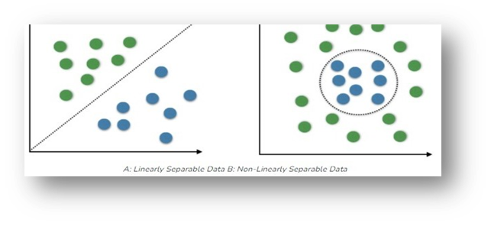
Background
SVM
(SVM) is a supervised machine learning algorithm that can be used for classification tasks. The primary goal of SVM is to find a hyperplane in an N-dimensional space (where N is the number of features) that distinctly classifies data points into different.

Slide 10
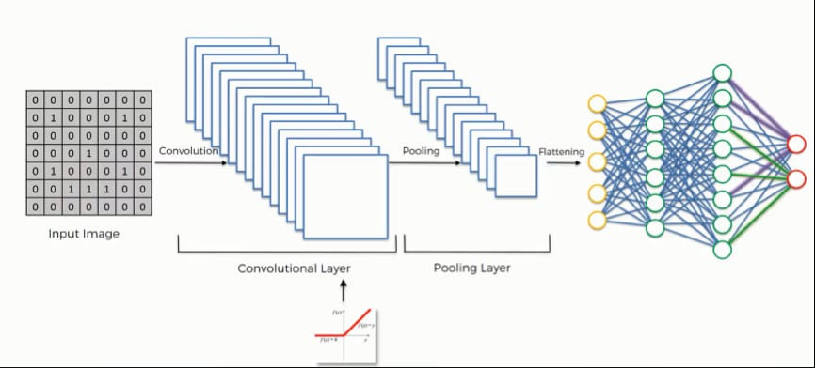
Background
CNN
A Convolutional Neural Network (CNN) is a type of deep learning algorithm specifically designed for processing structured grid data such as images. CNNs are highly effective for tasks involving visual data, like image classification, object detection, and image generation

Slide 11
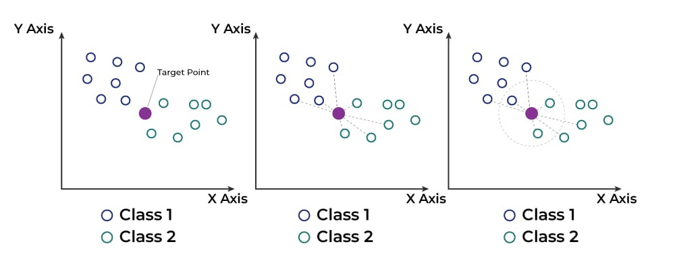
Background
KNN
The K-Nearest Neighbors (KNN) algorithm is a classification algorithm used for classifying data points. It works based on the idea of classifying a new element (such as a face image) by considering its similarity to other elements in the training dataset. KNN is considered a simple yet powerful algorithm.

Slide 12

Methodology
01
Framework
02
Data Collection
03
Data Preprocessing
04
Evaluation
05
Tools

Slide 13

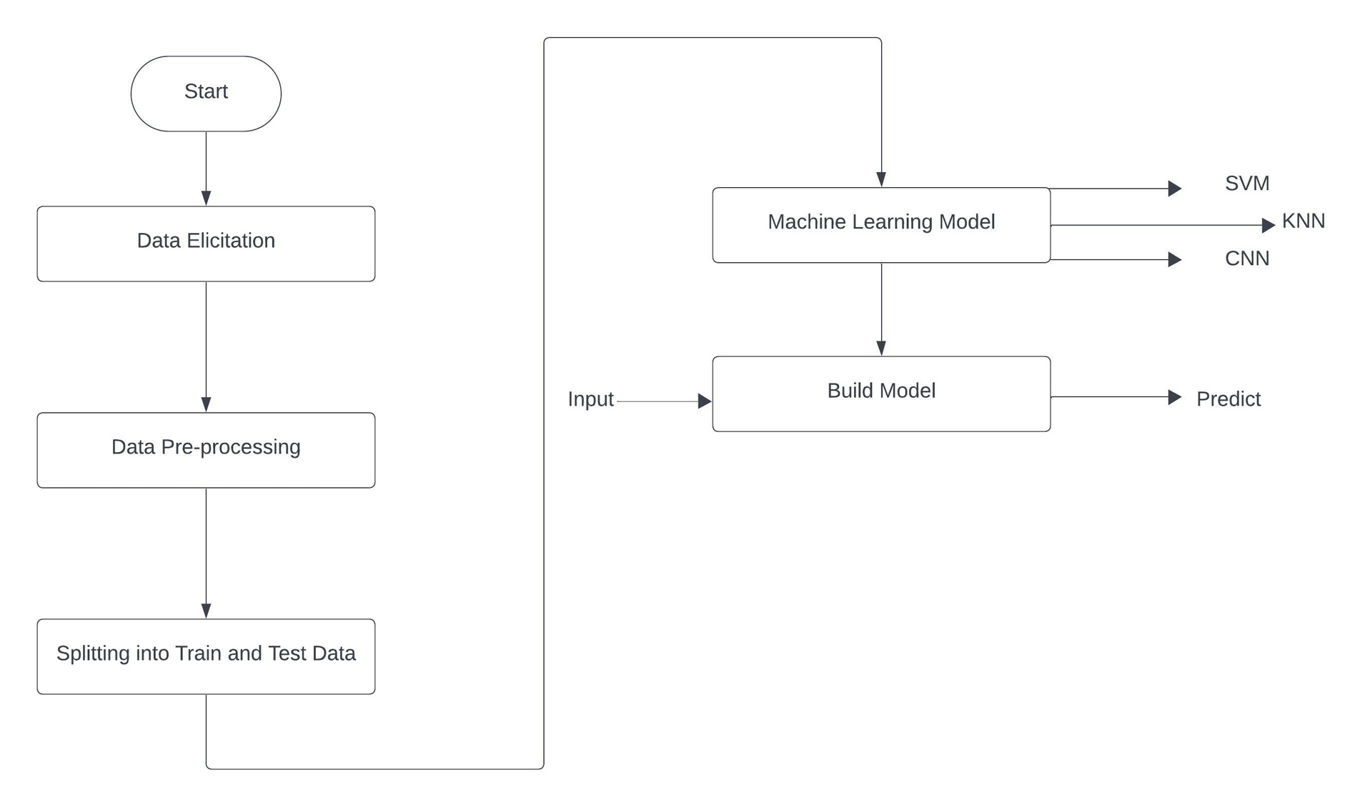
Framework

Slide 14

Data Collection
Collect a large dataset of facial images with different emotions. We used The CKP Facial Expression Database is a well-known dataset used in the field of Facial Emotion Recognition (FER), including seven classes such as Angry, Fear, Happy, contempt, Sad, Surprise and Disgust.

Slide 15
Data Collection
Collect a large dataset of facial images with different emotions. We used The MMI Facial Expression Database is a well-known dataset used in the field of Facial Emotion Recognition (FER), including six classes such as Angry, Fear, Happy, Neutral, Sad, and Surprise.

Slide 16
Data Preprocessing & augmentation
Preprocess the collected data by resizing, cropping, duplicating, transforming RGB to grayscale and normalizing the images to ensure consistency in the dataset.

Slide 17

CONT`D
MMI
CKP
NAME OF CATEGORY | BEFORE
NAME OF CATEGORY | BEFORE
AFTER
AFTER
Angry
131
524
Angry
135
540
Surprise
132
528
Contempt
54
216
Disgust
177
708
Natural
52
203
Fear
75
308
Fear
72
284
Sadness
84
336
Sadness
144
192
Happy
828
207
Happy
57
228
Surprise
249
996

Slide 18

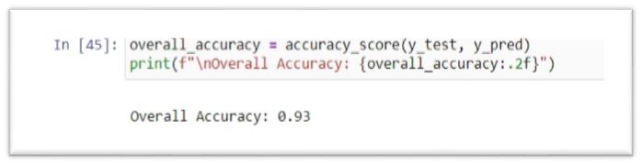
Evaluation
SVM
firstly, after using the SVM and training the model on the dataset, we evaluated the accuracy of each category as shown in the figure and also the overall accuracy of 93%

Slide 19
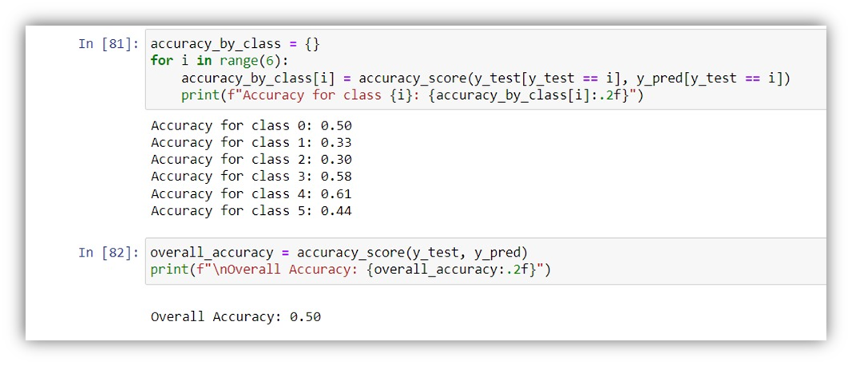
CONT`D
KNN
Secondly we used the KNN and training the model on the dataset, we evaluated the accuracy of each category as shown in the figure and also the overall accuracy of 50%

Slide 20
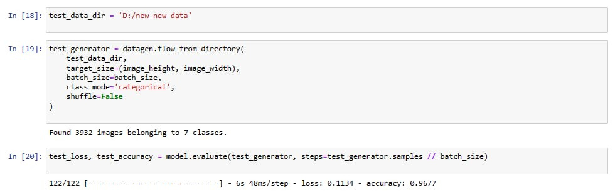
CONT`D
CNN
In the end, we used the CNN and training the model on the dataset, we evaluated the accuracy of each category as shown in the figure and also the overall accuracy of 96.7%

Slide 21



Tools
TOOLS
NAME OF TOOLS | ICON | UTILIZATION
Jupyter Notebook is an interactive computing environment. It is widely used for developing and testing AI models with Python due to its support for real-time code execution and rich media output.
Anaconda jupyter notebook
train machine learning models without needing to write any code. It is designed to make machine learning accessible to everyone, including those without a technical background.
Teachable machine
open-source code editor that supports multiple programming languages and offers features like flutter and dart
Visual studio code

Slide 22

Conclusion
The conclusion summarizes the successful creation of a facial expression recognition model in Python using different libraries and different algorithms such as CNN, which gave an accuracy of 96.7%, KNN, an accuracy of 50%, SVM, an accuracy of 93%, and a successful mobile application that works efficiently.

Slide 23

Future Work
Expand the application to detect and recognize the emotions of multiple individuals within the frame simultaneously.
Enhance the app to not only recognize basic emotions but also classify their intensity levels (e.g., mild sadness versus intense sadness).
Improvement in Recognition Accuracy
To improve accuracy in facial emotion recognition, one effective approach is through data augmentation. This technique involves increasing the diversity and quantity of training examples. By generating synthetic data or applying transformations such as rotations, translations, and changes in lighting and facial expressions, the model can learn to generalize better across different variations of facial expressions. This broader and more diverse dataset helps the model capture a wider range of facial features and nuances, thereby enhancing its ability to accurately recognize emotions in real-world scenarios.

Slide 24
THANK YOU

